Slide 1

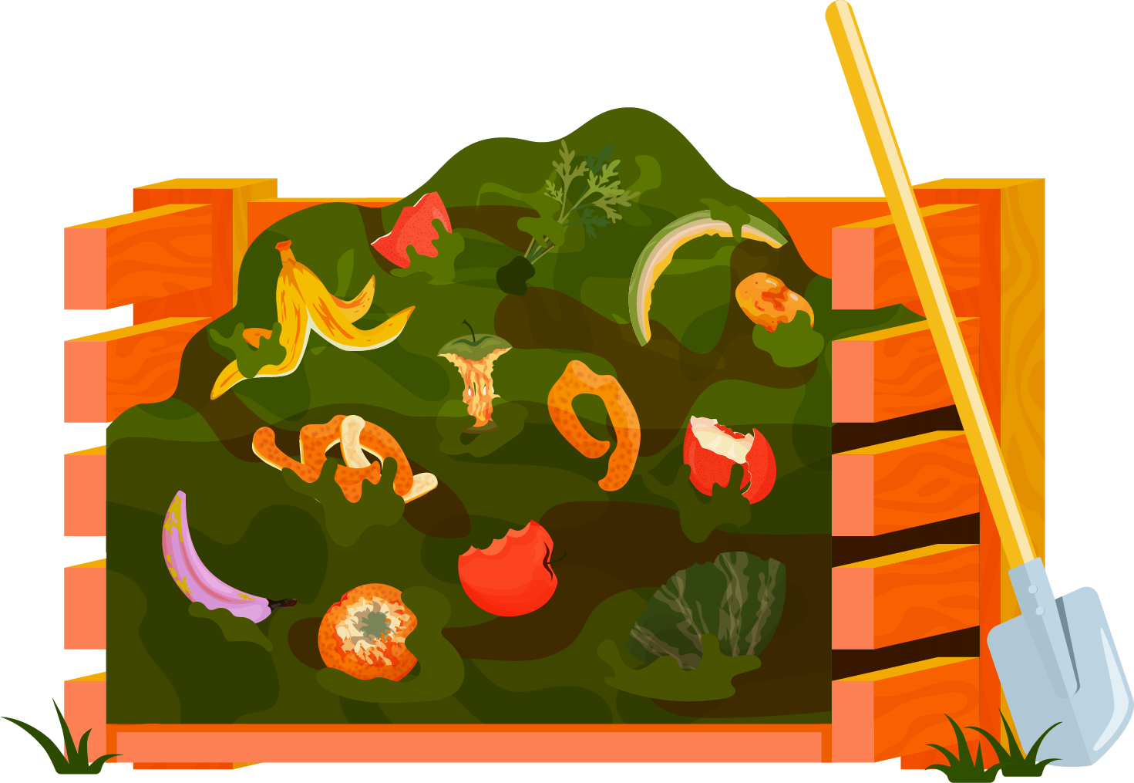

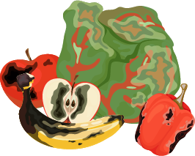
Trash Bash
Fenix and Isha

Slide 2



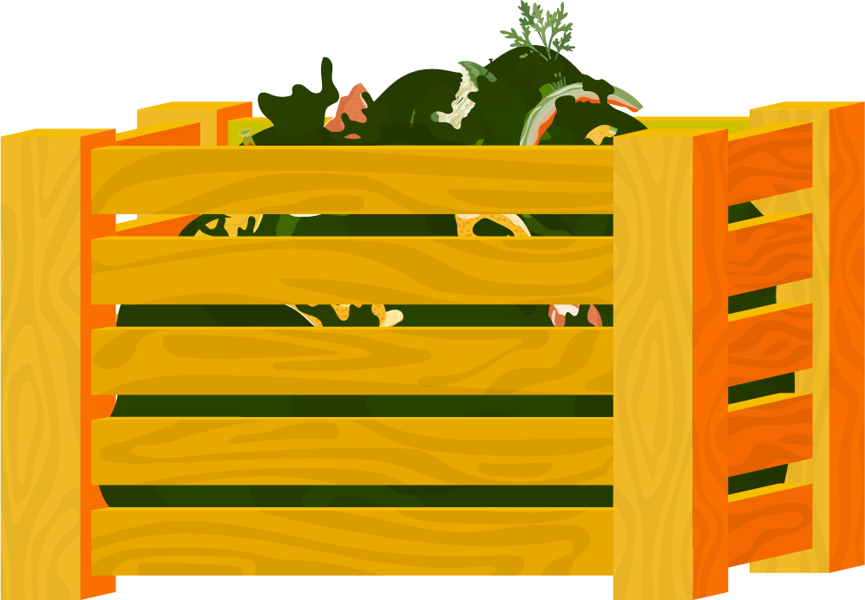
Table of contents
01
02
03
04
Problem
Success Criteria
Design
Demonstration

Slide 3

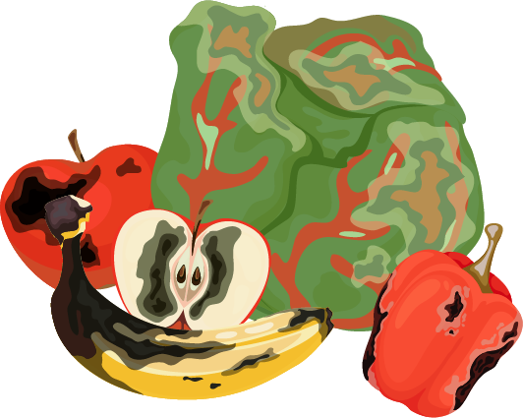

Problem
01

Slide 4
Problem Statement
We will educate young children on the importance and value of cleaning up garbage pollution from the ocean through a fun and engaging game.

Slide 5
Success Criteria
02

Slide 6
Success Criteria
The user must see a “how to play” menu
The user must see their score and time
The user must be able to move the trash and recycling separately
The counter must increase when the trash or recycling is captured correctly
Incorrect captures must terminate the game
Capturing an animal must lead to the game ending

Slide 7
Design
03

Slide 8
Design
We used JavaFX with SceneBuilder to develop this program. This game was centered on organizing trash. The players have to organized trash into garbage and recycling as it washes up on shore. There are also trick objects like animals which result in the game ending if the player captures them.

Slide 9
Demonstration
04

Slide 10

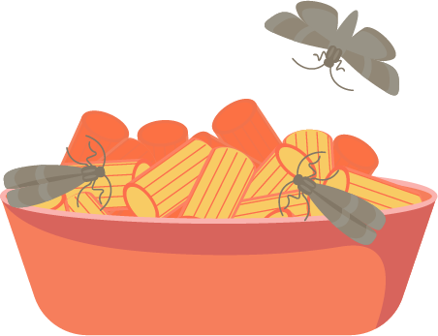


Thanks for listening!

